Slide 1
Phase 14 Data Focus and Feature Selection
Supervised By
Dr Sabah Mohammad
Presented By
Revanth Yenugudhati

Slide 2
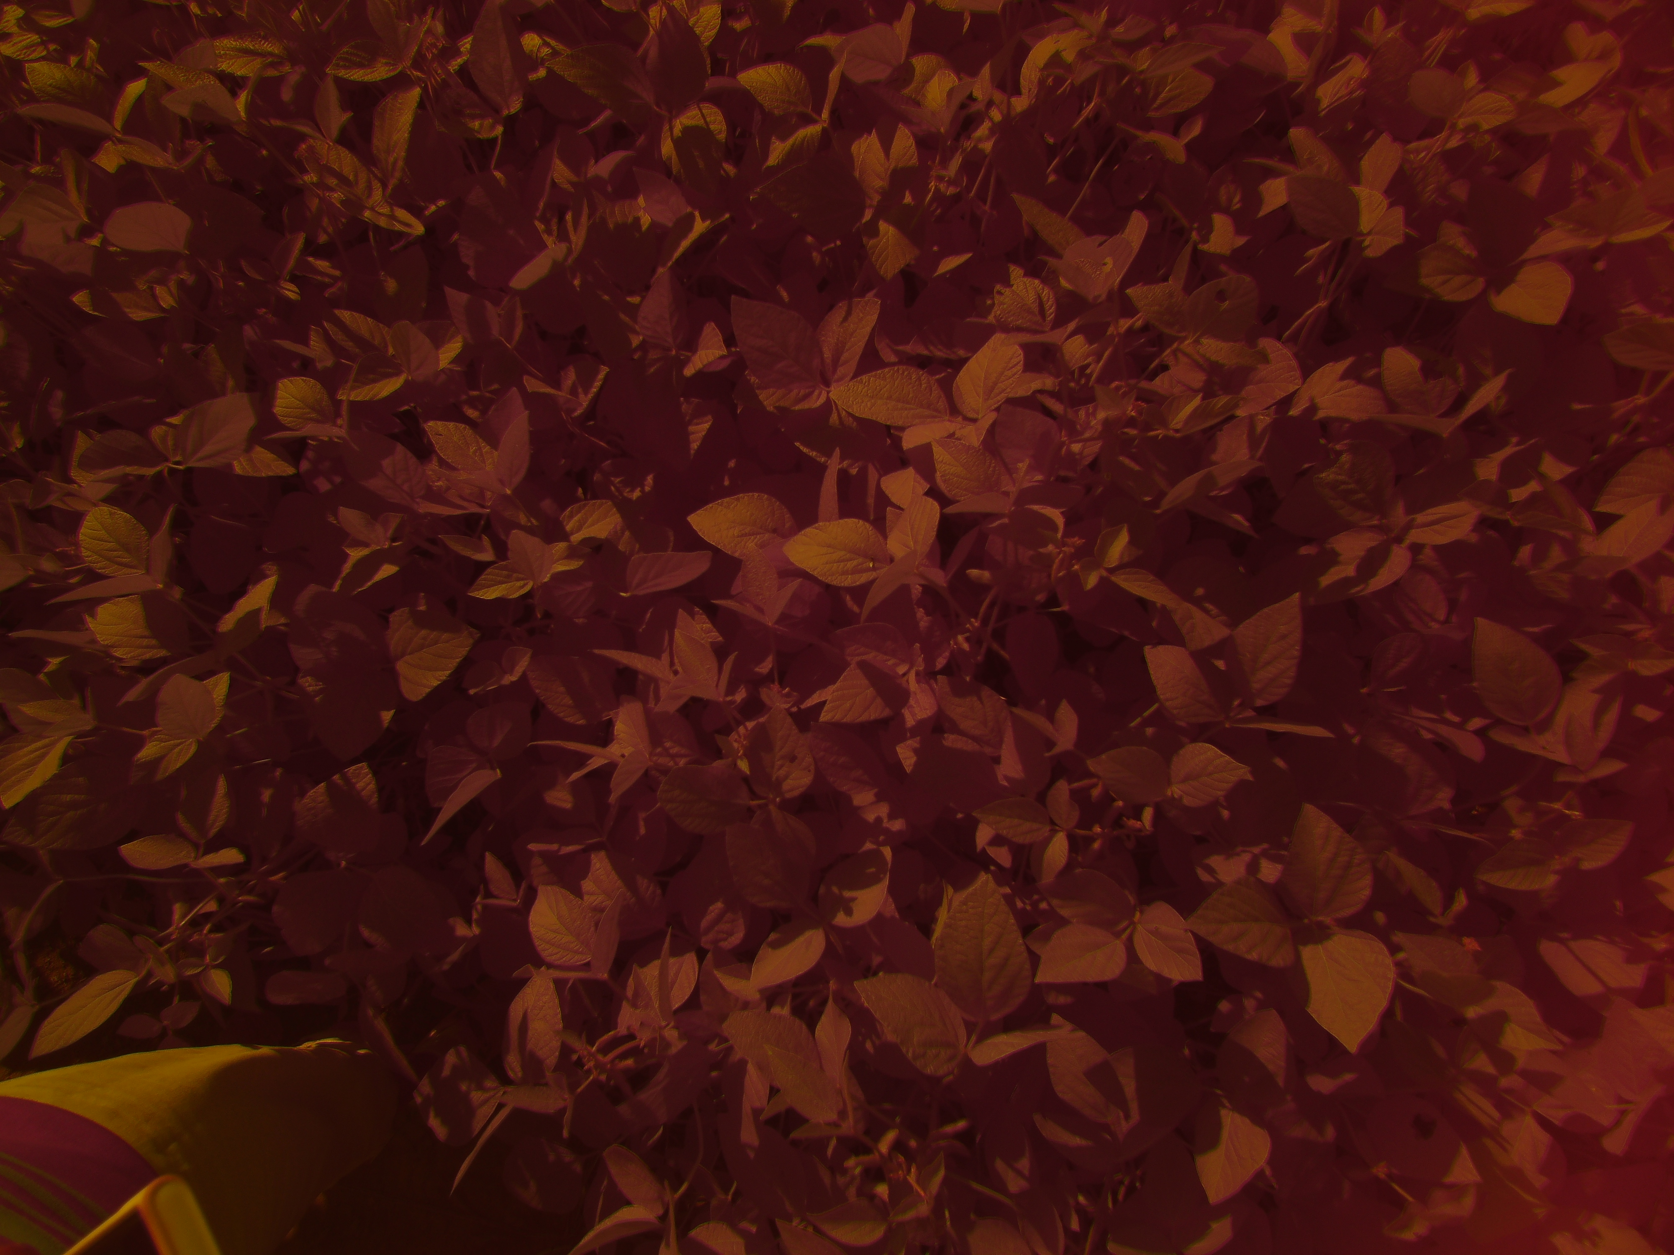
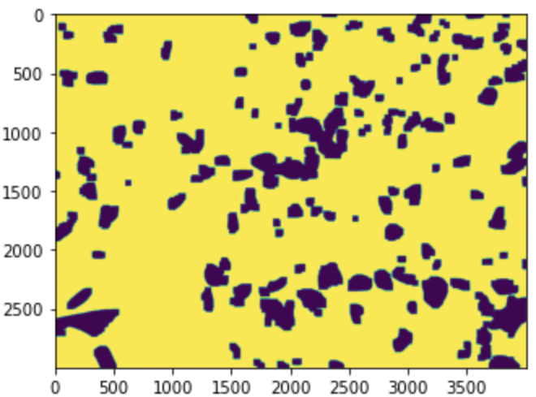
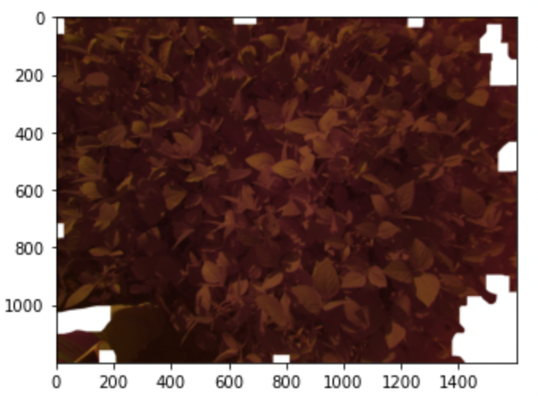
Preprocessing Image:
The image is preprocessed for focusing on the plant area rather than the excess background.
The image is converted into the grayscale image and gaussian blur is applied along with OTSU algorithm in which the result would be focusing on plant.
Original Image
Image after applying Gaussian
Blur and OTSU alogirthm
Result Image

Slide 3
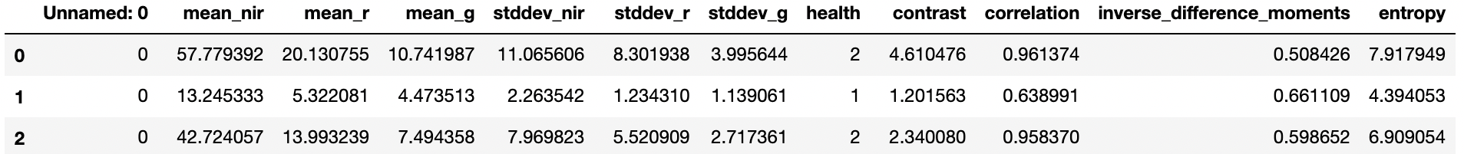
Feature Selection:
For NDVI calculation colors play important role. So calculated colour feature from images Extracted NIR, Red and Green bands from the images.
Texture features helps us in identifying the region of interest. Texture features like Correlation, entropy contrast have been taken.

Slide 4
Thank You!

